Slide 1
Acknowledge
Specially thank Martin Hall for his sharing of the material and lecture notes of books “Core Web Programming, Second Edition” and “Core Servlets and JSP”
HTML

Slide 2
Session 1 -
HyperText Markup Language (HTML)
Designing Documents for the
World Wide Web

Slide 3
Agenda
Introduction to HTML
Creating and publishing a Web page
Validating a document
Main HMTL elements
Block-level HTML elements
Text-level HTML element
Creating hypertext links
Adding images to documents
Building tables
HTML
Notes:
Preparation:
Validator website
http://www.htmlhelp.com/tools/validator/
http://validator.w3.org/
Applet webpage: http://java.sun.com/applets/jdk/1.4/index.html

Slide 4
The World Wide Web
Definitions
  The World Wide Web
    The set of computers on the Internet that support HTTP
    Not a separate network.
  HTTP
    The HyperText Transfer Protocol.
    The language used by a WWW client (e.g. Netscape, Internet Explorer) to request documents from a WWW server (i.e. the program running at Web sites like amazon.com or yahoo.com)
  HTML
    The HyperText Markup Language
    The language used to design web pages
HTML
Notes:
You must be visited many websites? Could I say WWW is Internet?
What is protocol?

Slide 5
HyperText Markup Language
Text Mixed with Markup Tags
  Tags Enclosed in Angle Brackets (<H1>Introduction</H1>)
What Does Markup Describe?
  Appearance
  Layout
  Content (Can’t Enforce an Exact Look)
Changes in HTML 3.2 to HTML 4.0
  Standardization of frames
  Deprecation of formatting elements (vs. style sheets)
  Improved cell alignment and grouping in tables
  Mouse and keyboard events for nearly all elements
  Internationalization features
HTML
Notes:
HTML version:
1.0: 1990, only very few people can know
2.0: 1995
3.2: January 1997,
4.0: December, 1997: until now, internet was still not popular.
4.01: 1999, The last HTML specification published by the W3C
2000, HTML also became an international standard (ISO/IEC 15445:2000)

Slide 6
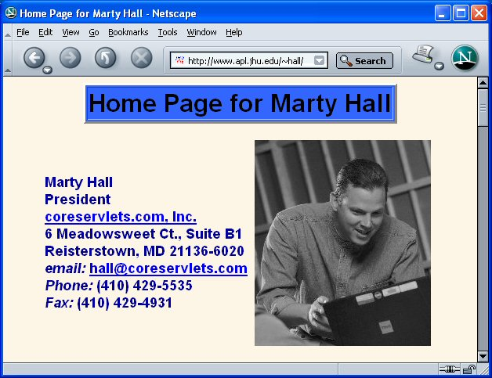
HTML Example
<!DOCTYPE HTML PUBLIC "-//W3C//DTD HTML 4.0 Transitional//EN">
<HTML>
<HEAD>
<TITLE>Home Page for Marty Hall</TITLE>
…
<BODY BGCOLOR="#FDF5E6" TEXT="#000000" LINK="#0000EE"
VLINK="#551A8B" ALINK="#FF0000">
<CENTER>
<TABLE BORDER=3 BGCOLOR="#3366FF">
<TR><TD><STRONG CLASS="title">Home Page for Marty Hall</STRONG></TD></TR>
</TABLE>
<P>
<TABLE>
<TR><TD><STRONG><B>Marty Hall</B><BR>
President<BR>
<A HREF="http://www.coreservlets.com/">
coreservlets.com, Inc.</A><BR>
6 Meadowsweet Ct., Suite B1<BR>
Reisterstown, MD 21136-6020<BR>
<I>email:</I>
<A HREF="mailto:hall@coreservlets.com">hall@coreservlets.com</A><BR>
<I>Phone:</I> (410) 429-5535<BR>
<I>Fax:</I> (410) 429-4931</STRONG></TD>
<TD><IMG SRC="images/Marty-JHU-Head-Small.jpg"
ALT="Marty" WIDTH="225" HEIGHT="263" HSPACE="5"></TD></TR>
</TABLE>…
HTML

Slide 7
Creating and Publishing a Web Page
Create an HTML document
Place the document in a world-accessible directory (often public_html or www) on a system running an HTTP server
    Unix> cd
    Unix> chmod a+x . (Note the ".")
    Unix> mkdir public_html
    Unix> chmod a+x public_html
Access the web page through http://hostname/~username/filename
    E.g. http://www.apl.jhu.edu/~hall/test.html
  If the filename is omitted, a system default filename is assumed (often index.html)
    E.g. http://www.apl.jhu.edu/~hall/ refers to the file index.html in hall’s public_html directory
HTML
Notes:
Public_html is known by a web server in Unix OS. It will access to retrieve the page you want
www is known by web server in Windows OS
chmod a+x = all+execute

Slide 8
Creating and Publishing a Web Page, cont.
Validate the Document
  Check the syntax using a formal HTML validator
    http://www.htmlhelp.com/tools/validator/
    http://validator.w3.org/
  The version of HTML against which the document is validated is based on the DOCTYPE
  <!DOCTYPE HTML PUBLIC "-//W3C//DTD HTML 4.0 Transitional//EN">
  The WWW Consortium recently added advice that Web pages include information on the character set, even though ASCII or Latin-1 is the default. The validator at http://validator.w3.org/ gives warnings if you omit this. You can ignore such warnings if you wish.
HTML
Notes:
Strict HTML 4.01 DOCTYPE <!DOCTYPE HTML PUBLIC "-//W3C//DTD HTML 4.01//EN">
Transitional HTML 4.01 DOCTYPE <!DOCTYPE HTML PUBLIC "-//W3C//DTD HTML 4.01 Transitional//EN">
Frameset HTML 4.01 DOCTYPE <!DOCTYPE HTML PUBLIC "-//W3C//DTD HTML 4.01 Frameset//EN">

Slide 9
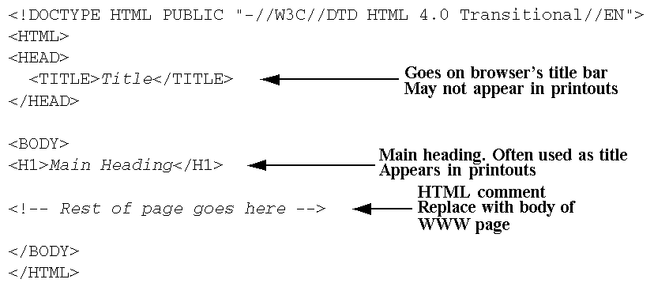
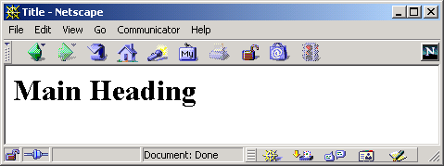
HTML Document Template
HTML

Slide 10
Main HTML Elements
DOCTYPE
HTML
HEAD
  TITLE element required
  Optional elements:
    BASE
    META
    BGSOUND
    SCRIPT, NOSCRIPT
    STYLE
    LINK
HTML

Slide 11
Main HTML Elements (Continued)
BODY Element
  <BODY BGCOLOR="YELLOW">
  HTML Attributes and Attribute Values
    BACKGROUND
    BGCOLOR
    TEXT
    LINK, VLINK, ALINK
    OnLoad, OnUnload, OnFocus, OnBlur,…
Elements inside BODY element
  <BODY>
  Remaining HTML elements
  </BODY>
HTML

Slide 12
META Element
Records document information, forwards and refreshes pages
  NAME="author"
  NAME="keywords"
  NAME="description"
  HTTP-EQUIV="refresh"
HTML
Notes:
HTTP-EQUIV: META tags are equivalent to HTTP header.
“Refresh”: ask the web browser to refresh after a certain period

Slide 13
META Element, Example
<!DOCTYPE HTML PUBLIC "-//W3C//DTD HTML 4.0 Transitional//EN">
<HTML>
<HEAD>
<TITLE>News Headlines</TITLE>
<META HTTP-EQUIV="REFRESH"
CONTENT="3600">
</HEAD>
<BODY>
<H1 ALIGN="CENTER">News Headlines</H1>
<H2>National News</H2>
Blah, blah, blah.
<H2>International News</H2>
Yadda, yadda, yadda.
</BODY>
</HTML>
HTML
Notes:
H1, H2: heading style like style in Microsoft Word

Slide 14
Block-Level Elements
Headings
  H1 ... H6
  ALIGN
Basic Text Sections
  P
  ALIGN
  PRE
  WIDTH
  ADDRESS
  BLOCKQUOTE
HTML

Slide 15
Block-Level Elements, cont.
Lists
  OL
  LI
  UL
  LI (the same with )
  DL
  DT
  DD
Tables and Forms (Postponed)
Misc.
  HR
  DIV
  CENTER
  MULTICOL (Netscape only)
HTML
Notes:
DL: Definition List
DT: Definition Term
DD: Definition Description

Slide 16
Headings
Heading Types
  <H1 ...> ... </H1>
  <H2 ...> ... </H2>
  <H3 ...> ... </H3>
  <H4 ...> ... </H4>
  <H5 ...> ... </H5>
  <H6 ...> ... </H6>
Attributes: ALIGN
  Values: LEFT (default), RIGHT, CENTER
Nesting tags
  Headings and other block-level elements can contain
  text-level elements, but not vice versa
HTML

Slide 17
Headings, Example
<!DOCTYPE HTML PUBLIC "-//W3C//DTD HTML 4.0 Transitional//EN">
<HTML>
<HEAD>
<TITLE>Document Headings</TITLE>
</HEAD>
<BODY>
Samples of the six heading types:
<H1>Level-1 (H1)</H1>
<H2 ALIGN="CENTER">Level-2 (H2)</H2>
<H3><U>Level-3 (H3)</U></H3>
<H4 ALIGN="RIGHT">Level-4 (H4)</H4>
<H5>Level-5 (H5)</H5>
<H6>Level-6 (H6)</H6>
</BODY>
</HTML>
HTML

Slide 18
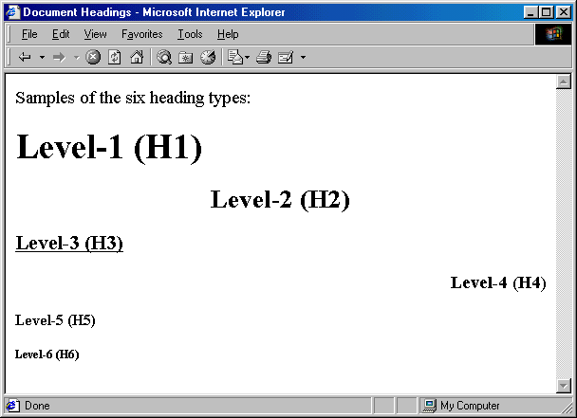
Headings, Result
HTML

Slide 19
P – The Basic Paragraph
Attributes: ALIGN
  LEFT (default), RIGHT, CENTER. Same as headings.
  Whitespace ignored (use <BR> for line break)
    Consecutive <P>’s do not yield multiple blank lines
  End Tag is Optional:
<BODY>
<P>
Paragraph 1
</P>
<P>
Paragraph 2
</P>
<P>
Paragraph 3
</P>
</BODY>
Fully-Specified
<BODY>
Paragraph 1
<P>
Paragraph 2
<P>
Paragraph 3
</BODY>
Equivalent with Implied Tags
HTML
Notes:
For current HTML, end tag </P> will generate error

Slide 20
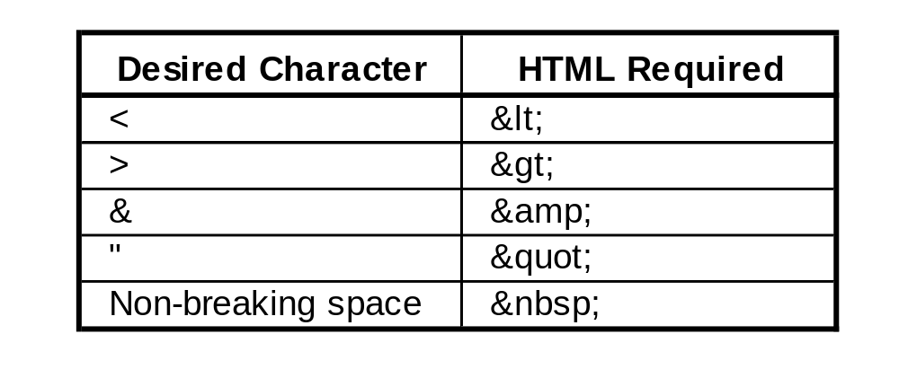
Preformatted Paragraphs
The PRE Element
  <PRE> ... </PRE>
Attributes: WIDTH
  Expected width in characters. Not widely supported.
Problem: Special Characters
  <PRE>
  if (a<b) {
  doThis();
  } else {
  doThat();
  }
  </PRE>
HTML

Slide 21

OL: Ordered (Numbered) Lists
OL Element
  <OL>
  <LI>…
  <LI>…
  ...
  </OL>
  Attributes: TYPE, START, COMPACT
List entries: LI
  <LI ...> ... </LI> (End Tag Optional)
  Attributes: (When inside OL) VALUE, TYPE
A sample list:
<OL>
<LI>List Item One
<LI>List Item Two
<LI>List Item Three
</OL>
HTML

Slide 22
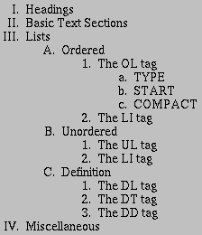
Nested Ordered Lists
<OL TYPE="I">
<LI>Headings
<LI>Basic Text Sections
<LI>Lists
<OL TYPE="A">
<LI>Ordered
<OL TYPE="1">
<LI>The OL tag
<OL TYPE="a">
<LI>TYPE
<LI>START
<LI>COMPACT
</OL>
<LI>The LI tag
</OL>
<LI>Unordered
<OL TYPE="1">
<LI>The UL tag
<LI>The LI tag
</OL>
<LI>Definition
<OL TYPE="1">
<LI>The DL tag
<LI>The DT tag
<LI>The DD tag
</OL>
</OL>
<LI>Miscellaneous
</OL>
HTML

Slide 23

UL: Unordered (Bulleted) Lists
UL Element
  <UL>
  <LI>…
  <LI>…
  ...
  </UL>
Attributes: TYPE, COMPACT
  TYPE is DISC, CIRCLE, or SQUARE
List entries: LI (TYPE)
  TYPE is DISC, CIRCLE, or SQUARE
A sample list:
<UL>
<LI>List Item One
<LI>List Item Two
<LI>List Item Three
</UL>
HTML

Slide 24
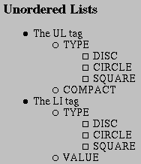
UL: Custom Bullets
<UL TYPE="DISC">
<LI>The UL tag
<UL TYPE="CIRCLE">
<LI>TYPE
<UL TYPE="SQUARE">
<LI>DISC
<LI>CIRCLE
<LI>SQUARE
</UL>
<LI>COMPACT
</UL>
<LI>The LI tag
<UL TYPE="CIRCLE">
<LI>TYPE
<UL TYPE="SQUARE">
<LI>DISC
<LI>CIRCLE
<LI>SQUARE
</UL>
<LI>VALUE
</UL>
</UL>
HTML

Slide 25
Text-Level Elements
Physical Character Styles
  B, I, TT, U, SUB, SUP, SMALL, BIG, STRIKE, Q, BLINK
  FONT
    SIZE
    COLOR
    FACE
  BASEFONT
  SIZE
Logical Character Styles
  EM, STRONG, CODE, SAMP, KBD, DFN, VAR, CITE
HTML
Notes:
TT: Teletyped

Slide 26
Text-Level Elements (Continued)
Hypertext Links
  A
    HREF, NAME, TARGET, ...
Images
  IMG
    SRC (required), ALT, ALIGN, WIDTH, HEIGHT, HSPACE, VSPACE, BORDER, USEMAP, ISMAP
Misc. Text-Level Elements
  BR (Explicit line break)
  AREA (Client-side image maps)
  APPLET (Java),
  ...
HTML

Slide 27
Physical Character Styles, Example
...
<H1>Physical Character Styles</H1>
<B>Bold</B><BR>
<I>Italic</I><BR>
<TT>Teletype (Monospaced)</TT><BR>
<U>Underlined</U><BR>
Subscripts: f<SUB>0</SUB> + f<SUB>1</SUB><BR>
Superscripts: x<SUP>2</SUP> + y<SUP>2</SUP><BR>
<SMALL>Smaller</SMALL><BR>
<BIG>Bigger</BIG><BR>
<STRIKE>Strike Through</STRIKE><BR>
<B><I>Bold Italic</I></B><BR>
<BIG><TT>Big Monospaced</TT></BIG><BR>
<SMALL><I>Small Italic</I></SMALL><BR>
<FONT COLOR="GRAY">Gray</FONT><BR>
<DEL>Delete</DEL><BR>
<INS>Insert</INS><BR>
...
HTML

Slide 28
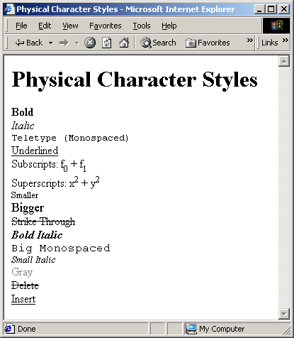
Physical Character Styles, Result
HTML

Slide 29
Logical Character Styles, Example
...
<H1>Logical Character Styles</H1>
<EM>Emphasized</EM><BR>
<STRONG>Strongly Emphasized</STRONG><BR>
<CODE>Code</CODE><BR>
<SAMP>Sample Output</SAMP><BR>
<KBD>Keyboard Text</KBD><BR>
<DFN>Definition</DFN><BR>
<VAR>Variable</VAR><BR>
<CITE>Citation</CITE><BR>
<EM><CODE>Emphasized Code</CODE></EM><BR>
<FONT COLOR="GRAY"><CITE>Gray Citation</CITE></FONT><BR>
<ACRONYM TITLE="Java Development Kit">JDK Acronym</ACRONYM>
...
HTML

Slide 30
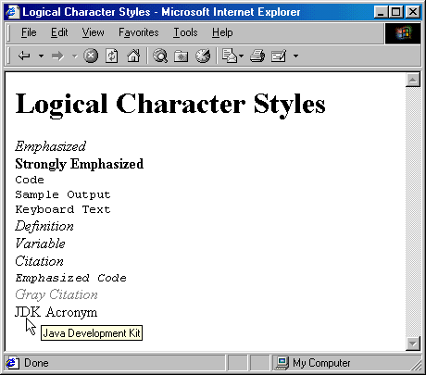
Logical Character Styles, Result
HTML

Slide 31
Hypertext Links
Links can contain images and other text-level elements (i.e., <A HREF…> ... </A>)
Link to Absolute URL
  Use a complete URL beginning with http://
    Java is discussed in
    <A HREF="http://host/path/chapter2.html">
    Chapter 2</A>.
Link to Relative URL
  Use a filename or relative path to filename
    Interpreted write location of current file
    Java is discussed in
    <A HREF="chapter2.html">Chapter 2</A>.
HTML

Slide 32
Hypertext Links
(Continued)
Link to Section
  Use a section name (see below) preceded by #
    Images are discussed in
    <A HREF="#Section2">Section 2</A>.
Link to Section in URL
  Use absolute or relative URL, then #, then section name
    Images are discussed in
    <A HREF="chapter1.html#Section2">
    Sec. 2 of Chap. 1</A>.
Naming a Section
  Use <A NAME="..."> and do not include the pound sign
    <H2><A NAME="Section2">Images</A></H2>
HTML

Slide 33
IMG: Embedding Images
Example
  <IMG SRC="SomeFile.gif" ALT="My Dog"
  WIDTH=400 HEIGHT=300>
Attributes:
  SRC (required)
  ALT (technically required)
  ALIGN (see <BR CLEAR="ALL">)
  WIDTH, HEIGHT
  HSPACE, VSPACE
  BORDER
  USEMAP, ISMAP
HTML

Slide 34
Image Alignment, Example
<!DOCTYPE HTML PUBLIC "-//W3C//DTD HTML 4.0 Transitional//EN">
<HTML>
<HEAD><TITLE>Image Alignment</TITLE></HEAD>
<BODY>
<H1 ALIGN="CENTER">Image Alignment</H1>
<TABLE BORDER=1>
<TR><TH>Alignment
<TH>Result
<TR><TH><CODE>LEFT</CODE>
<TD><IMG SRC="rude-pc.gif" ALIGN="LEFT"
ALT="Rude PC" WIDTH=54 HEIGHT=77>
This positions the image at the left side,
with text flowing around it on the right.
<TR><TH><CODE>RIGHT</CODE>
<TD><IMG SRC="rude-pc.gif" ALIGN="RIGHT"
ALT="Rude PC" WIDTH=54 HEIGHT=77>
This positions the image at the right side,
with text flowing around it on the left.
...
</TABLE>
</BODY>
</HTML>
HTML

Slide 35
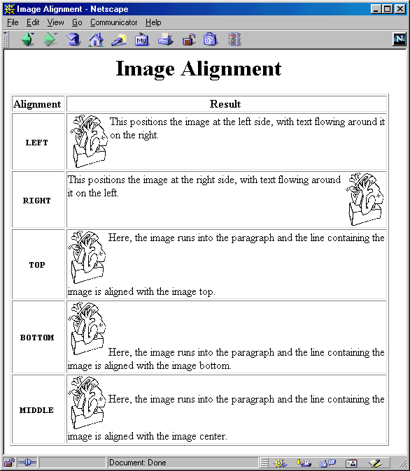
Image Alignment, Result
HTML

Slide 36
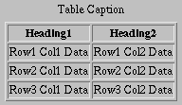
Tables
Template
  <TABLE BORDER=1>
  <CAPTION>Table Caption</CAPTION>
  <TR><TH>Heading1</TH> <TH>Heading2</TH></TR>
  <TR><TD>Row1 Col1 Data</TD><TD>Row1 Col2 Data</TD></TR>
  <TR><TD>Row2 Col1 Data</TD><TD>Row2 Col2 Data</TD></TR>
  <TR><TD>Row3 Col1 Data</TD><TD>Row3 Col2 Data</TD></TR>
  </TABLE>
HTML

Slide 37
TABLE Element Attributes
ALIGN
  The ALIGN attribute gives the horizontal alignment of the table as a whole
  Legal values are LEFT, RIGHT, and CENTER, with LEFT being the default
BORDER
  This specifies the width in pixels of the border around the table
  This is in addition to the border around each cell (the CELLSPACING).
  The default is zero, which also results in the visible 3D divider between cells being turned off
CELLSPACING
  This gives the space in pixels between adjacent cells. Drawn as a 3D line if BORDER is nonzero, otherwise empty space in the background color is used
  The default is usually about 3
HTML

Slide 38
TABLE Element Attributes
(Continued)
CELLPADDING
  CELLPADDING determines the empty space, in pixels, between the cell’s border and the table element
  The default is usually about 1
WIDTH
  This specifies the width of the table, either in pixels (<TABLE WIDTH=250>) or as a percentage of the current browser window width (<TABLE WIDTH="75%">)
BGCOLOR
  Specify the background color of the table TABLE (also legal for TR, TD, and TH)
BORDERCOLOR, BORDERCOLORDARK,
BORDERCOLORLIGHT
  Non standard attributes supported by IE to specify the colors to user for the borders
HTML

Slide 39
TABLE Element Attributes (Continued)
BACKGROUND
  This nonstandard attribute supported by IE gives an image file that will be tiled as the background of the table
  You might want to use style sheets instead.
RULES
  HTML 4.0 attribute that specifies which inner dividing lines are drawn
  All are drawn if this attribute is omitted
  Legal values are NONE, ROWS, COLS, and ALL
FRAME
  Specifies which outer borders are drawn
  All four are drawn if this attribute is omitted
  Legal values are BORDER or BOX (all), VOID (none), ABOVE (top), BELOW (bottom), HSIDES (top and bottom, despite the somewhat confusing name), VSIDES (left and right), LHS (left), and RHS (right)
HTML

Slide 40
Table CAPTION
Attribute
  ALIGN (Values: TOP, BOTTOM)
Usage
  An enclosing borderless table may give more flexibility than the built-in CAPTION.
HTML

Slide 41
TR: Table Row
TR is used to define each row in the table
Each row will then contain TH and/or TD entries
ALIGN
  ALIGN (legal values LEFT, RIGHT, or CENTER) is used to set the default horizontal alignment for table cells
VALIGN
  VALIGN (legal values TOP, MIDDLE, or BOTTOM) is used to set the default vertical alignment for table cells
BGCOLOR
  Sets the color for the table row, overriding any values set for the table as a whole via the BGCOLOR attribute of TABLE
BORDERCOLOR, BORDERCOLORDARK,
BORDERCOLORLIGHT
  Supported only by Internet Explorer, these specify the colors to use for the row borders
HTML

Slide 42

Table Cells: TH and TD
COLSPAN
  COLSPAN defines a heading or cell data entry that spans multiple columns
    <TABLE BORDER=1>
    <TR><TH COLSPAN=2>Col 1&2 Heading
    <TH>Col3 Heading
    <TR><TD>Col1 Data
    <TD>Col2 Data
    <TD>Col3 Data
    </TABLE>
HTML

Slide 43
Table Cells: TH and TD (Continued)
ROWSPAN
  ROWSPAN defines a heading or cell data entry that spans multiple rows; similar to COLSPAN
ALIGN
  LEFT, RIGHT, CENTER, JUSTIFY and CHAR.
  E.g., the following aligns entries on a decimal point
<TD ALIGN="CHAR" CHAR=".">
VALIGN
  TOP, BOTTOM, MIDDLE
WIDTH, HEIGHT
  Values in pixels only (no percentages officially allowed)
NOWRAP
  Use with caution
BGCOLOR, BACKGROUND
  Same as for TABLE and TR
HTML

Slide 44
Summary
A DOCTYPE is required to validate the document
HTML document should have an enclosing HTML element, a HEAD (TITLE is required) and a BODY
Documents are composed of block-level and
text-level elements
  Text-level elements must be inside block-level elements, not vice versa
Hypertext links, <A HREF="…">,
can be absolute or relative
  A link to a named section is denoted by #section
Tables are composed of main table element, <TABLE>; rows, <TR>; table headers, <TH>;
and table data, <TD>
  Use BGCOLOR to give background colors to tables, rows, or cells
  Use ROWSPAN or COLSPAN to join cells
HTML

Slide 45
Thank for your listening
Question?
Introduction

Slide 46
HTML Frames

Slide 47
Agenda
Advantages and disadvantages of frames
FRAME template
Defining rows and cols in a FRAMESET
Common FRAME and FRAMESET attributes
Nested frames
Targeting a document to a named
FRAME cell
HTML
Notes:
Last homework: Your CV? How does it look like? Could you show me your CV?

Slide 48
Frame Advantages
Certain parts of the interface (e.g., a TOC) are always on the screen
Can avoid retyping common sections of multiple Web pages
Consistent use across a large site sometimes simplifies user navigation
A convenient way to mix text-oriented HTML with Java applets
Image maps are more convenient if the map image remains on screen and only the results section changes
HTML

Slide 49
Frame Disadvantages
The meaning of the “Back” and “Forward” buttons can be confusing
Poorly designed frames can get the user lost
Hard to find real URL of a page you want
  Printing problems!
Hard to bookmark "configuration"
Some very old browsers do not support frames
Security
  Hackers can insert frame cells into your pages in some circumstances, perhaps stealing information intended for your site
HTML
Notes:
Show example “Frames.html”
Show why poor design can get the user lost?
What is printing problem? → What frame to be printed?
Bookmarks? How can we navigate to bookmark?

Slide 50
Frame Template
<!DOCTYPE HTML PUBLIC "-//W3C//DTD HTML 4.0 Frameset//EN">
<HTML>
<HEAD><TITLE>Document Title</TITLE></HEAD>
<FRAMESET ...>
<!-- FRAME and Nested FRAMESET Entries -->
<NOFRAMES>
<BODY>
<!-- Stuff for non-Frames browsers -->
</BODY>
</NOFRAMES>
</FRAMESET>
</HTML>
HTML

Slide 51
FRAMESET Attributes
COLS, ROWS
  A comma-separated list of pixel values, percentages, and weighted remainders
  FRAMESET entries should always specify at least two rows or columns. Netscape problems if not!
  Examples
<FRAMESET ROWS="50,10%,*,2*">
...
</FRAMESET>
<FRAMESET COLS="25%,*,*">
...
</FRAMESET>
HTML

Slide 52
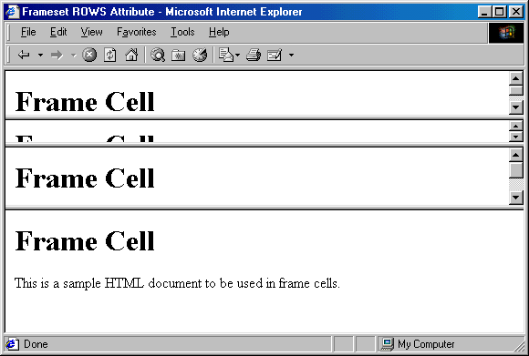
FRAMESET ROWS, Example
      <FRAMESET ROWS="50,10%,*,2*">
      ...
      </FRAMESET>
HTML

Slide 53
FRAMESET Attributes (Continued)
FRAMEBORDER
  Indicates whether borders will be drawn between frame cells
  YES or 1 specifies borders; NO or 0 specifies no border
  Can be overridden by FRAMEBORDER settings in individual FRAME entries
  Often used in conjunction with BORDER=0 and FRAMESPACING=0
BORDER (Netscape), FRAMESPACING (IE)
  Specify the thickness of the border between cells
  Apply to outermost FRAMESET only
BORDERCOLOR
  Sets the color of the border between cell, using either a hex RGB value or color name
HTML

Slide 54
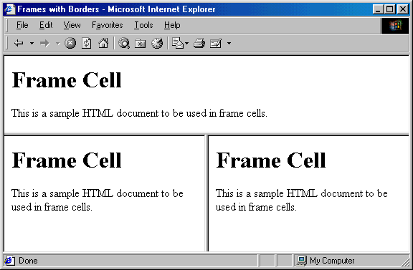
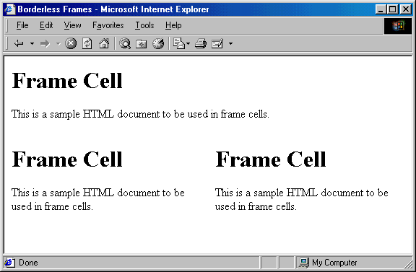
Frame Border, Examples
HTML

Slide 55
FRAME: Specifying Content of Frame Cells
SRC
  URL of the document to place in the frame cell
NAME
  Supplies destination for TARGET attribute of hypertext links
FRAMEBORDER, BORDERCOLOR
MARGINWIDTH, MARGINHEIGHT
  Specifies the left/right and top/bottom cell margins, respectively
SCROLLING
  Indicates whether cells should have scrollbars
NORESIZE
  Disables the ability to resize the frame cells
HTML

Slide 56
Frame Example 1
<!DOCTYPE HTML PUBLIC "-//W3C//DTD HTML 4.0 Frameset//EN">
<HTML>
<HEAD><TITLE>Frame Example 1</TITLE></HEAD>
<FRAMESET ROWS="55%,45%">
<FRAMESET COLS="*,*,*">
<FRAME SRC="Frame-Cell.html">
<FRAME SRC="Frame-Cell.html">
<FRAME SRC="Frame-Cell.html">
</FRAMESET>
<FRAMESET COLS="*,*">
<FRAME SRC="Frame-Cell.html">
<FRAME SRC="Frame-Cell.html">
</FRAMESET>
<NOFRAMES>
<BODY>
Your browser does not support frames. Please see
<A HREF="Frame-Cell.html">non-frames version</A>.
</BODY>
</NOFRAMES>
</FRAMESET>
</HTML>
HTML

Slide 57
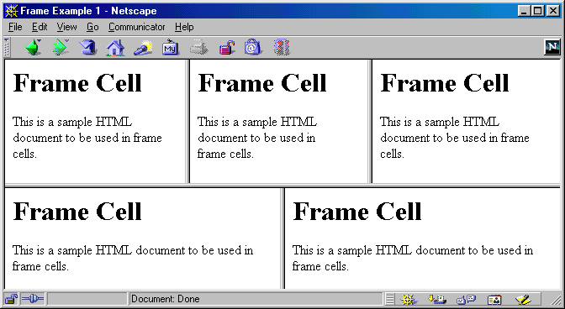
Frame Example 1, Result
HTML

Slide 58
Frame Example 2
<!DOCTYPE HTML PUBLIC "-//W3C//DTD HTML 4.0 Frameset//EN">
<HTML>
<HEAD><TITLE>Frame Example 2</TITLE></HEAD>
<FRAMESET COLS="55%,45%">
<FRAMESET ROWS="*,*,*">
<FRAME SRC="Frame-Cell.html">
<FRAME SRC="Frame-Cell.html">
<FRAME SRC="Frame-Cell.html">
</FRAMESET>
<FRAMESET ROWS="*,*">
<FRAME SRC="Frame-Cell.html">
<FRAME SRC="Frame-Cell.html">
</FRAMESET>
<NOFRAMES>
<BODY>
Your browser does not support frames. Please see
<A HREF="Frame-Cell.html">nonframes version</A>.
</BODY>
</NOFRAMES>
</FRAMESET>
</HTML>
HTML

Slide 59
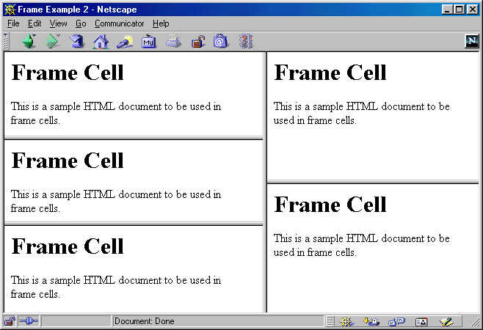
Frame Example 2, Result
HTML
Notes:
Give exercise about screen division

Slide 60
Targeting Frame Cells
Specify the cell in which to place a page referenced by a hyperlink
The NAME Attribute of FRAME
<FRAME SRC="..." NAME="cellName">
The TARGET Attribute of A HREF
<A HREF="..." TARGET="cellName">
HTML

Slide 61
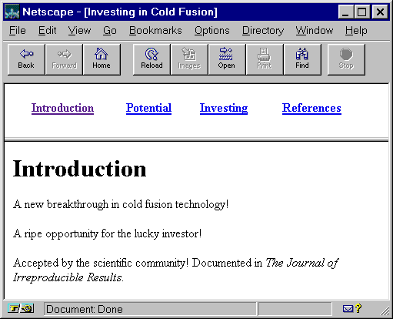
Targeting Example
HTML

Slide 62
Cold-Fusion.html
<!DOCTYPE HTML PUBLIC "-//W3C//DTD HTML 4.0 Frameset//EN">
<HTML>
<HEAD>
<TITLE>Investing in Cold Fusion</TITLE>
</HEAD>
<FRAMESET ROWS="75,*">
<FRAME SRC="TOC.html" NAME="TOC">
<FRAME SRC="Introduction.html" NAME="Main">
<NOFRAMES>
<BODY>
This page requires Frames. For a non-Frames version,
<A HREF="Introduction.html">the introduction</A>.
</BODY>
</NOFRAMES>
</FRAMESET>
</HTML>
HTML

Slide 63
TOC.html
<!DOCTYPE HTML PUBLIC "-//W3C//DTD HTML 4.0 Transitional//EN">
<HTML>
<HEAD>
<TITLE>Table of Contents</TITLE>
</HEAD>
<BODY>
<TABLE WIDTH="100%">
<TR><TH><A HREF="Introduction.html" TARGET="Main">
Introduction</A></TH>
<TH><A HREF="Potential.html" TARGET="Main">
Potential</A></TH>
<TH><A HREF="Investing.html" TARGET="Main">
Investing</A></TH>
<TH><A HREF="References.html" TARGET="Main">
References</A></TH></TR>
</TABLE>
</BODY>
</HTML>
HTML

Slide 64
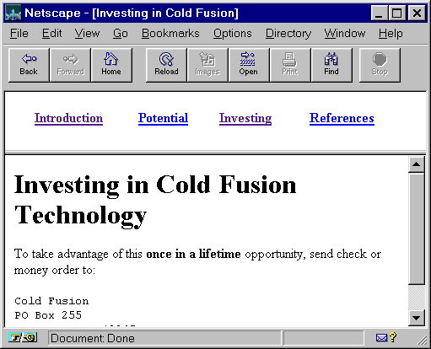
Targeting Example, Results
HTML

Slide 65
Predefined Frame Names
_blank
  Load document into a new browser window
_top
  Causes the linked document to take up the whole browser window
  Document will not be contained in a frame cell
_parent
  Places document in the immediate FRAMESET parent
  Same as _top if no nested frames
_self
  Place document in current cell
  Only necessary to override a BASE entry
HTML
Notes:
Give an exercise for personal home page.

Slide 66
Summary
Frames require a Frameset DOCTYPE for validation
A FRAMESET can be divided either into columns or rows
  To create both rows and columns use nested FRAMESETs
By giving a FRAME a name, documents can be targeted to the named frame cell
  <FRAME … NAME="…">
  <A HREF="…" TARGET="…">
There are four predefined frame names
  _blank, _top, _parent, and _self
HTML

Slide 67
Cascading
Style Sheets

Slide 68
Agenda
Specifying style sheet rules
External and inline style specifications
Creating new HTML elements through style sheet classes
Specifying font and text properties
Controlling foreground and background properties
Netscape LAYERs
Creating layers through style sheets
HTML
Notes:
Give example like Microsoft Word → using style in Word for demonstration

Slide 69
Benefits of Cascading Style Sheets
Powerful and flexible way to specify the formatting of HTML elements
  Can define font, size, background color, background image, margins, etc.
Share style sheets across multiple documents or entire Web site
Can specify a class definition for a style, effectively defining new HTML elements
Rules are applied in a hierarchical manner (precedence rules)
HTML

Slide 70
Cascading Style Sheets
CSS, Level 1 (1996)
  Concerned with applying simple styles to HTML elements
  http://www.w3.org/TR/REC-CSS1
CSS, Level 2 (1998)
  Supports media-specific style sheets (visual browsers, aural devices, printers, braille devices)
  http://www.w3.org/TR/REC-CSS2
CSS, Level 3 (draft 2001)
  Focused on modularization of the CSS specification
  http://www.w3.org/TR/css3-roadmap/
Note:
  CSS1 is supported by Netscape and Internet Explorer 4.x and above
  See http://www.webreview.com/style/css1/charts/mastergrid.shtml for a summary of browser compatibility
HTML

Slide 71
Specifying Style Rules
General form of rule
selector { property: value }
or
selector { property1: value1;
property2: value2;
...
propertyN: valueN }
Example
H1 { text-align: center;
color: blue }
HTML

Slide 72
Fizzics1.html, Example
(no style sheet)
<!DOCTYPE HTML PUBLIC "-//W3C//DTD HTML 4.0 Transitional//EN">
<HTML>
<HEAD>
<TITLE>New Advances in Physics</TITLE>
</HEAD>
<BODY>
<H1>New Advances in Physics</H1>
<H2>Turning Gold into Lead</H2>
In a startling breakthrough, scientist B.O. "Gus" Fizzics
has invented a <STRONG>practical</STRONG> technique for
transmutation! For more details, please see
<A HREF="give-us-your-gold.html">our transmutation thesis</A>.
...
</BODY>
</HTML>
HTML

Slide 73
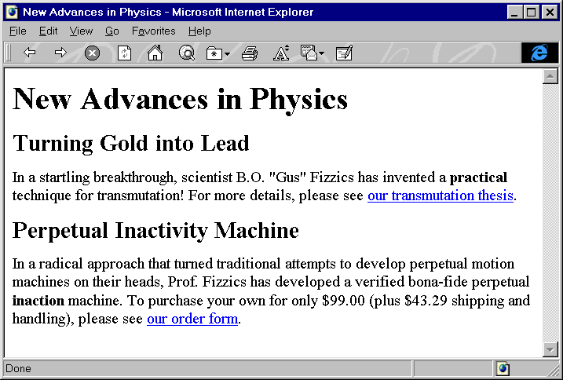
Fizzics1.html, Result
(no style sheet)
HTML

Slide 74
Fizzics2.html, Example
(with style sheet)
Style information
<HEAD>
<TITLE>Document Title</TITLE>
<STYLE TYPE="text/css">
<!--
BODY { background: URL(images/confetti-background.jpg) }
H1 { text-align: center;
font-family: Blackout }
H2 { font-family: MeppDisplayShadow }
STRONG { text-decoration: underline }
-->
</STYLE>
</HEAD>
HTML

Slide 75
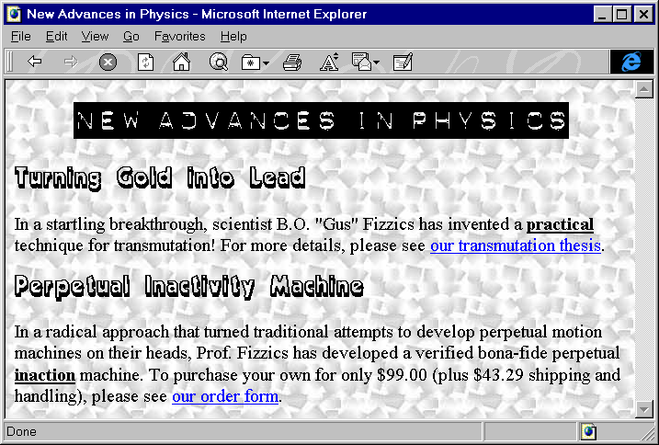
Fizzics2.html, Result
(with style sheet)
HTML
Notes:
Show example objects.html

Slide 76
External Style Sheets
Specify link to external style sheet in the HEAD section of the HTML document
<LINK REL=STYLESHEET
HREF="Sitestyle.css" // Absolute or relative link
TYPE="text/css">
Sitestyle.css
/* Example of an external style sheet */
H1 { text-align: center;
font-family: Arial
}
H2 { color: #440000;
text-align: center;
font-family: Arial Black, Arial, Helvetica, sans-serif
}
...
HTML

Slide 77
Inline Style Specification
Use the STYLE attribute defined for each HTML element to directly specify the style
Example
...
<H1>New Advances in Physics</H1>
<P STYLE="margin-left: 0.5in;
margin-right: 0.5in;
font-style: italic">
This paper gives the solution to three
previously unsolved problems: turning lead into gold,
antigravity, and a practical perpetual motion machine.
...
HTML

Slide 78
Defining Style Classes
To define an element style class proceed the HTML element by a period and class name
// Define an "abstract" paragraph type
P.abstract { margin-left: 0.5in;
margin-right: 0.5in;
font-style: italic }
To use, supply the name of the style class in the CLASS attribute of the HTML element
<H1>New Advances in Physics</H1>
<P CLASS="abstract">
This paper gives the solution to three previously
unsolved problems: turning lead into gold,
antigravity, and a practical perpetual motion machine.
HTML

Slide 79
Defining Style Classes
To define a global style class, omit the element name
// Style available to all elements
.blue { color: blue; font-weight: bold }
To use, simple specify the style class in the CLASS attribute of the HTML element
<H2 CLASS="blue">A Blue Heading</H2>
<!-- Apply to a section of text -->
This text is in the default color, but
<SPAN CLASS="blue">this text is blue.</SPAN>
HTML

Slide 80
Defining Styles through
User-Defined IDs
An ID is like a class but can be applied only once in a document
<HEAD>
<TITLE>...</TITLE>
<STYLE TYPE="text/css">
<!--
#foo { color: red }
-->
</STYLE>
</HEAD>
<BODY>
...
<P ID="foo">
...
</BODY>
HTML

Slide 81
Style Sheet Precedence Rules
Rules marked “important” have the highest priority (rarely used)
H1 { color: black !important;
font-family: sans-serif }
Author rules have precedence over reader rules
  Style sheet rules override browser preferences
HTML
Notes:
Important will override user-defined rules

Slide 82
Style Sheet Precedence Rules, cont.
More specific rules have precedence over less specific rules
#foo { ... } // ID selector highest priority
P.big H1 { ... } // Class higher over element
P STRONG { ... } // Two tags higher than single tag
STRONG H1 { ... }
In case of tie, the last rule has priority
HTML
Notes:
<P ID=“foo” CLASS=“big”>
Question: <STRONG> What rule will be applied? </STRONG>

Slide 83
Useful Font Properties
font-weight
  Relative weight (boldness) of font
  normal | lighter | bold | bolder | 100 | 200 | ... | 900
  H1 { font-weight : 200 }
  H2 { font-weight : bolder }
font-style
  Font face type within a family
  normal | italic | oblique
  P { font-style : normal }
  TH { font-sytle : italic }
HTML

Slide 84
Useful Font Properties, cont.
font-size
  Either relative or absolute size of font
  pt, pc, in, cm, mm | em, ex, px, % |
  xx-large | x-large | large | medium | small | x-small |
  xx-small | smaller | larger
STRONG { font-size: 150% }
P { font-size: 14pt }
P { font-size: xx-large }
font-family
  Typeface family for the font
  H1 { font-family: Arial }
HTML
Notes:
em: the 'font-size' of the relevant font
ex: the 'x-height' of the relevant font
px: pixels, relative to the viewing device
pc: picas is also a word in: español. A measurement system used by printers and Desktop Publishing applications. 1 inch = 6 picas.
pt: points, independent to the viewing device

Slide 85
CampBearClaw.html, Example
<!DOCTYPE HTML PUBLIC "-//W3C//DTD HTML 4.0 Transitional//EN">
<HTML>
<HEAD>
<TITLE>Camp Bear Claw</TITLE>
<LINK REL=STYLESHEET HREF="CampBearClaw.css" TYPE="text/css">
</HEAD>
<BODY>
<H1>Camp Bear Claw</H1>
We have the following activities:
<H2 CLASS="archery">Archery</H2>
<H2 CLASS="arts">Arts and Crafts</H2>
<H2 CLASS="horseback">Horseback Riding</H2>
<H2 CLASS="hiking">Hiking</H2>
<H2 CLASS="campfire">Campfire Song Times</H2>
<H2 CLASS="java">Java Programming</H2>
</BODY>
</HTML>
HTML

Slide 86
CampBearClaw.css
H1 { text-align: center;
font-family: Funstuff }
H2.archery { font-family: ArcheryDisplay }
H2.arts { font-family: ClampettsDisplay }
H2.horseback { font-family: Rodeo }
H2.hiking { font-family: SnowtopCaps }
H2.campfire { font-family: Music Hall }
H2.java { font-family: Digiface }
HTML

Slide 87
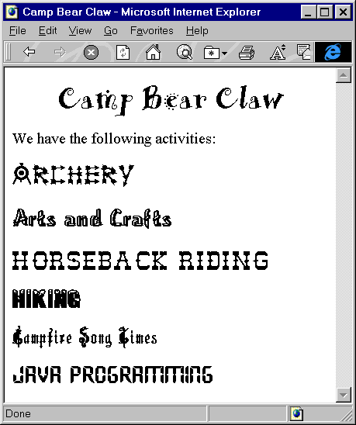
CampBearClaw.html, Result
HTML

Slide 88
Useful Text Properties
text-decoration
  Describes text additions or “decorations” that are added to the text of an element
  none | underline | overline | line-through | blink
  P { text-decoration: underline }
vertical-align
  Determines how elements are positioned vertically
  top | bottom | baseline | middle | sub | super | text-top | text-bottom | %
text-align
  Determines how paragraphs are positioned horizontally
  left | right | center | justify
HTML

Slide 89
Useful Text Properties, cont.
text-indent
  Specifies the indentation of the first line of the paragraph
  +/– pt, pc, in, cm, mm | +/– em, ex, px, %
  P { text-indent: -25px } /* Hanging indent */
line-height
  Specifies the distance between two consecutive baselines in a paragraph
  normal | number | pt, pc, in, cm, mm | em, ex, px, %
  .double { line-height: 200% }
  .triple { line-height: 3 } /* 3x the font size */
  DIV { line-height: 1.5em }
HTML

Slide 90
Bates.html
<!DOCTYPE HTML PUBLIC "-//W3C//DTD HTML 4.0 Transitional//EN">
<HTML>
<HEAD>
<TITLE>An Open Letter to the IRS</TITLE>
<LINK REL=STYLESHEET HREF="Bates.css" TYPE="text/css">
</HEAD>
<BODY BACKGROUND="images/bond-paper.jpg">
<P CLASS="rhead">
April 1, 2001
<HR>
<P CLASS="rhead">
William A. Bates<BR>
Macrosoft Corporation<BR>
Blumond, WA 12345
<P CLASS="lhead">
Internal Revenue Service<BR>
Philadelphia, PA 67890
<P>
<BR>
Dear Sirs,
<P CLASS="body">
I am writing to inform you that, due to financial difficulties,
...
HTML

Slide 91
Bates.css
P { margin-top: 5px }
P.rhead { text-align: right;
margin-right: 0.5in;
font-family: sans-serif }
P.lhead { font-family: sans-serif }
P.body { text-align: justify;
text-indent: 0.5in }
P.foot { margin-left: 60%;
line-height: 300% }
HTML

Slide 92
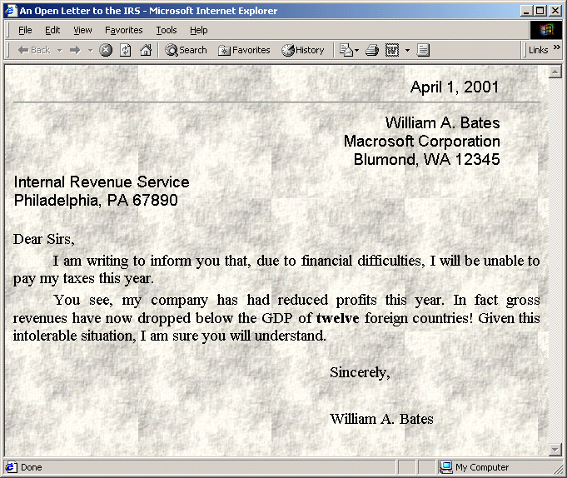
Bates.html
HTML

Slide 93
Useful Foreground and Background Properties
color
  Color of the text or foreground color
  color-name | #RRGGBB | #RGB | rgb(rrr, ggg, bbb) | rgb(rrr%, ggg%, bbb%)
  P { color : blue }
  H1 { color : #00AABB }
  H3 { color : rgb(255, 0, 0 ) } /* red */
background-image
  none | url(filename)
  Specifies an image to use as the background of region
  H2 { background-image: url(Bluedrop.gif);}
HTML

Slide 94
Useful Foreground and Background Properties, cont.
background-repeat
  Specifies how to tile the image in the region
  repeat | repeat-x | repeat-y | norepeat
    BODY {
    background-image: url(Bluedot.gif);
    background-repeat: repeat-x;
    }
background
  Lets you combine properties in a single entry
  P { background: url(wallpaper.jpg) repeat-x }
HTML

Slide 95
Cabinets.html, Example
<!DOCTYPE HTML PUBLIC "-//W3C//DTD HTML 4.0 Transitional//EN">
<HTML>
<HEAD>
<TITLE>Joe's Cabinets</TITLE>
<LINK REL=STYLESHEET HREF="Cabinets.css" TYPE="text/css">
</HEAD>
<BODY>
<CENTER>
<TABLE WIDTH=360 HEIGHT=199>
<TR><TD ALIGN="CENTER" CLASS="banner">Joe's Cabinets
</TABLE>
</CENTER>
<P>
Welcome to Joe's Cabinets. We specialize in
<UL>
<LI>Custom Cabinets
<LI>Kitchen Remodeling
<!-- Etc -->
</UL>
<!-- Etc -->
</BODY>
</HTML>
HTML

Slide 96
Cabinets.css
.banner { background: url(images/boards.jpg) repeat-x;
font-size: 50pt;
font-family: Arial Rounded MT Bold }
HTML

Slide 97
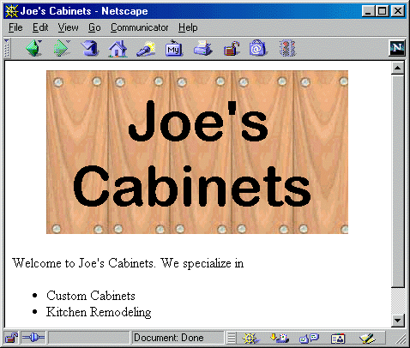
Cabinets.html, Result
HTML

Slide 98
Properties of the Bounding Box
CSS assume that all elements result in one or more rectangular regions (bounding box)
Styles can specify the margins, borders, and padding of the bounding box
P { margin: 0.25in;
border: 0.25in solid black;
padding: 0.25in;
background: URL(images/bond-paper.jpg) }
HTML

Slide 99
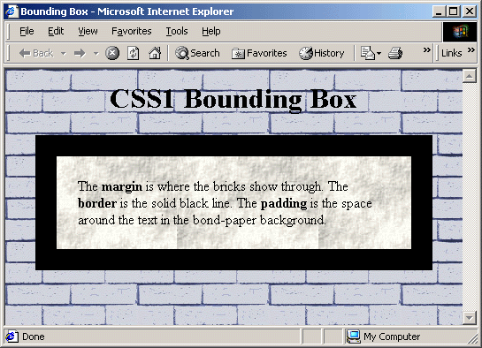
The Bounding Box
HTML

Slide 100
Images and Floating Elements
width, height
  Specify a fixed size for an element (usually an image)
  auto | pt, pc, in, cm, mm | em, ex, px
IMG.bullet { width: 50px; height: 50px }
float
  This property lets elements float into the left or right margins where the text wrapping arounds
  none | left | right
HTML

Slide 101
Psalm23.html
<!DOCTYPE HTML PUBLIC "-//W3C//DTD HTML 4.0 Transitional//EN">
<HTML>
<HEAD>
<TITLE>The 23rd Psalm</TITLE>
<STYLE>
<!--
SPAN { float: left;
font-family: "Cushing Book";
font-size: 75pt }
-->
</STYLE>
</HEAD>
<BODY>
<H2 ALIGN="CENTER">
The 23rd Psalm (King James Version)</H2>
<SPAN>T</SPAN>he LORD is my shepherd; I shall not want.
He maketh me to lie down in green pastures: he leadeth me
beside the still waters. He restoreth my soul: he leadeth me
in the paths of righteousness for his name's sake. Yea,
HTML

Slide 102
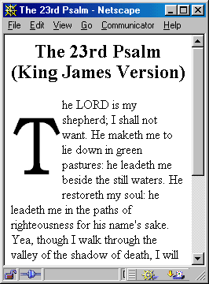
Psalm23.html, Result
The float property can be used
to implement “drop caps”
HTML

Slide 103
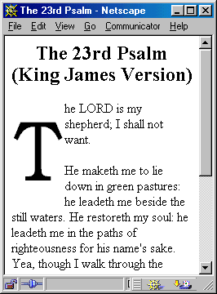
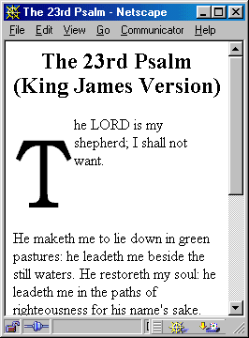
Effect of Paragraph Breaks, Example, cont.
Adding a <P> element simply
continues the flow
Adding <P STYLE="clear: left"> forces the next paragraph to start after the floating element
HTML

Slide 104
Summary
Through style sheets you can specify the general formatting of HTML elements
Use external style sheets to share styles across all documents in the Web site
Class definitions allow you to define multiple styles for an HTML element
HTML

